Slide 1
ENGINEERING PHYSICS
Unit 1: Wave Optics: Interference and Diffraction of Light

Slide 2
Index
Lecture 1 - Wave Optics: Interference in Thin Film | 10
Lecture 2 - Wave Optics: Interference in thin Transparent parallel film due to reflected light | 08
Lecture 3 - Wave Optics: Interference in thin Transparent parallel film due to transmitted light | 06
Lecture 4 – Wave Optics: Wedge shaped thin film | 08
Lecture 5 – Wave Optics: Newton’s Rings | 08
Lecture 6 – Wave Optics: Applications: ATR, HTR, Thickness Measurements, Optical Flatness | 02
Lecture 7 – Wave Optics: Introduction to Diffraction | 04
Lecture 8 – Wave Optics: Single Slit Diffraction and Double slit | 05
Lecture 9 – Wave Optics: N slit and Gratings | 06
Lecture 10 – Wave Optics: Resolving Power | 08

Slide 3
Lecture 1 : Wave Optics
Interference in thin film

Slide 4
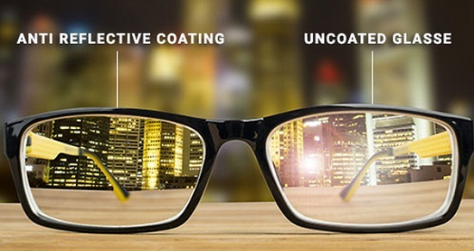
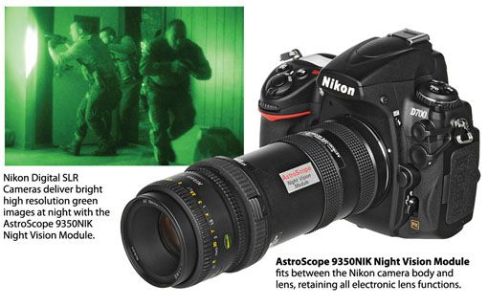
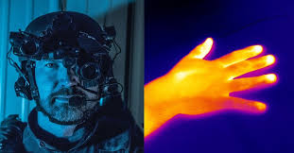
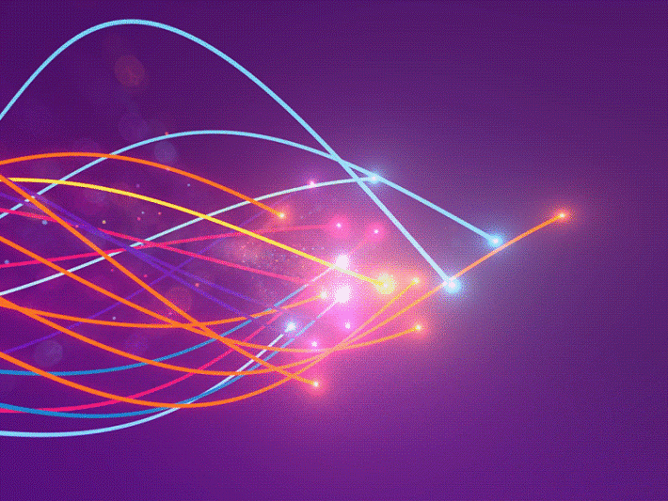
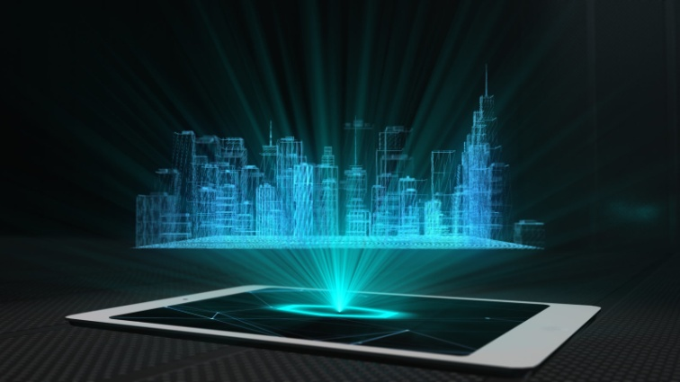
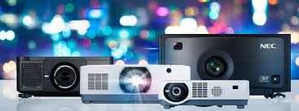
Why Wave Optics in Engineering?
DSLR Cameras
Night Vision Cameras
Lasers
Fiber Optics
Displays
Holography
Projectors

Slide 5
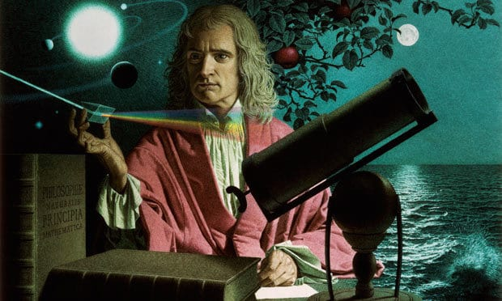
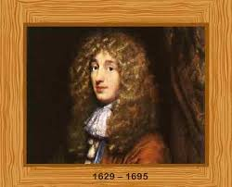
Historical Background and Foundations:
In the 17th century, the properties of light were explained by Sir Isaac Newton and Christian Huygens.
Corpuscular theory in 1675.
It explains reflection, refraction, and dispersion properties of light.
It fails to explain interference, diffraction, polarization, photo electric effect, and double refraction.
In 1679, Christian Huygens proposed the wave theory of light.
It explains reflection, refraction, dispersion, double refraction, diffraction, interference, and polarization properties of light. It fails to explain, photo electric effect, black body radiation etc.
Einstein received Nobel Prize

Slide 6
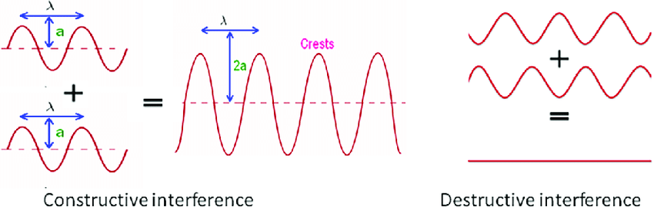
Interference in thin film :- Introduction
The modification / redistribution of intensity of light obtained by
Superposition of two or more beams
Resultant intensity (Amplitude) is greater than the original beams:
Constructive interference
But if the resultant intensity (Amplitude) is zero:
Destructive interference.

Slide 7
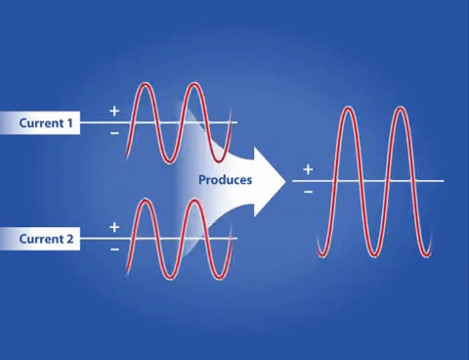
Conditions required for sustained interference
Same frequency and coherent sources
Comparable Amplitudes of the interfering waves
Two sources should be monochromatic.
Same state of polarization

Slide 8
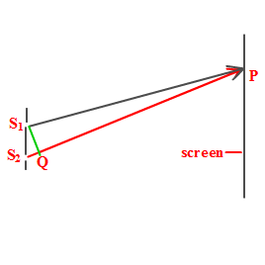

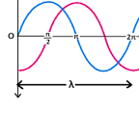
Optical path Difference (Δ) and Phase Difference (φ):
Geometrical path Difference (Δ) = S₂P- S₁P
Optical path Difference (Δ) = μ ( S₂P- S₁P)
Phase Difference =
Δ= n λ for n= 0,1,2… Constructive
Δ= (2n±1) λ/2……… Destructive

Slide 9
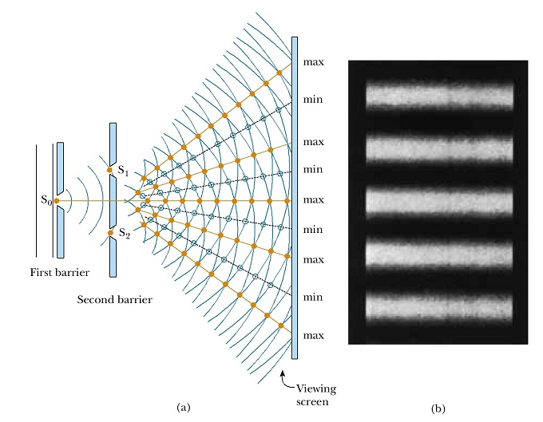
Methods of producing Sustained (Steady State) Interference:
Division of Wave front A Single wave front is physically divided into two by a pair of slits, or a mirror , or a bi-prism and brought together to produce interference. A point source is used. Example: Young’ s double slit experiment
Young’s Double Slit Experiments

Slide 10
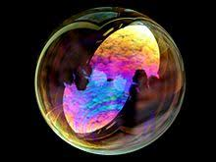
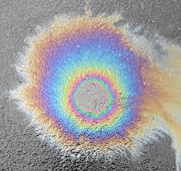
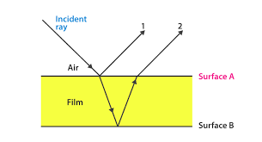
Division of Amplitude
When light rays travels through a transparent thin film, Intensity (amplitude) get distributed in multiple reflections.
An extended , broad source of light is used to observe interference.
Example: Colors of a soap bubble , Oil slick etc

Slide 11

Questions and Source Materials
Can you find interference in your classroom?
If yes, why you can not see fringes (steady state interference pattern)?
Video Lectures
https://nptel.ac.in/courses/122/107/122107035/
https://www.youtube.com/watch?v=WTxDyYHaYAI
https://www.youtube.com/watch?v=zYJssqt2MXk

Slide 12
Unit No: 1: Wave Optics
Lecture No: 2
Interference in thin
Transparent parallel film due to reflected light

Slide 13
Interference due to reflected light by thin transparent parallel film
Thin Film = thickness ~ 550 nm ~ λ
Ray1
Ray2

Slide 14
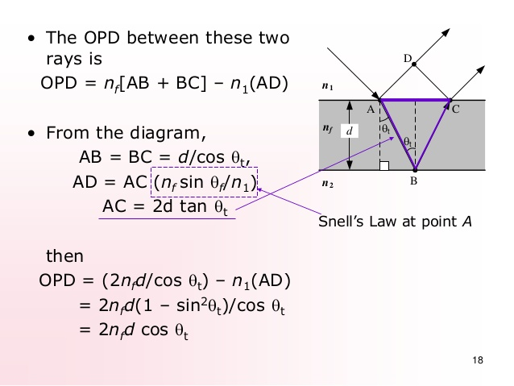

The optical path difference due to reflected light
The optical path difference between ray1 and ray2 is

Slide 15
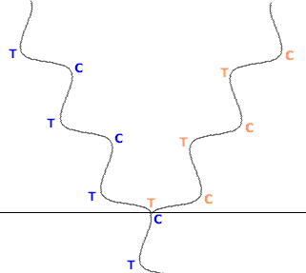
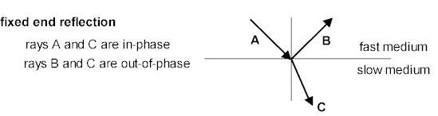
Optical path difference under reflected light
OPD = Δ = 2 µt cos (r)
According to Stokes's law when light is reflected from interface of optically rarer medium (low refractive index) to denser medium (higher refractive index), the ray gets inverted resulting in a phase change of π rad which corresponds to a path difference of λ/2.
The effective path difference is
Δ eff =2 µ t cosr + λ/2
Rarer medium
Δ_{eff} =2 µ t cosr + λ/2
Denser medium
Rarer medium
Denser medium

Slide 16
Condition for maxima and minima due to reflected light
For constructive interference
  2 μ t cos r =(2n±1) λ/2 n = 0, 1, 2 …
  For normal incidence ∠r=0⁰
  2 μ t = (2n±1) λ/2 n = 0, 1, 2 …
For destruction interference
  2 μ t cos r = n λ n = 0, 1, 2 …
  For normal incidence ∠r=0°
  2 μ t = n λ n = 0, 1, 2 2 μ t = n λ n = 0, 1, 2 …
We get constructive interference when the path difference is λ_{film}/2, 3λ_{film}/2, 5λ_{film}/2, etc.
We get destructive interference when the path difference is 0, λ_{film,} ,2λ_{film} , 3λ_{fil ,etc}

Slide 17
Questions and Source Materials
Why different colors appear on oil slicks on the roads?
What do you mean by thin film ??
Video Lectures
https://nptel.ac.in/courses/122/107/122107035/
https://www.youtube.com/watch?v=WTxDyYHaYAI
https://www.youtube.com/watch?v=zYJssqt2MXk
https://www.youtube.com/watch?v=j0YVQOx3DeA

Slide 18
Unit No 1 : Interference in thin film
Lecture No: 3
Interference in thin
Transparent parallel film due to Transmitted light

Slide 19
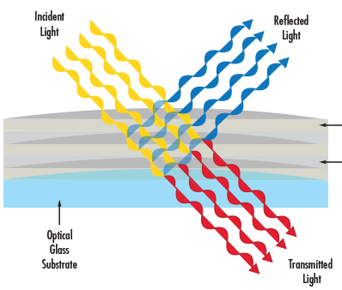
Interference due to Transmitted light

Slide 20
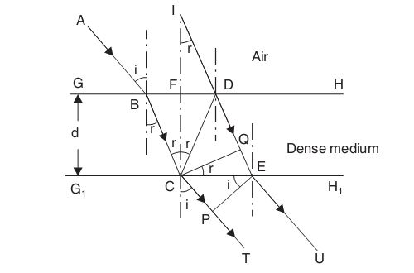
Interference due to Transmitted light
Interference takes place between the transmitted rays CT and EU.
They are derived from the same incident ray AB and hence coherent . By division of amplitude interference takes place.
The optical path difference between rays Δ = (C D + DE ) µ — CP µ air
The transmitted ray CT undergoes no phase change with respect to the incident wave because it is travelling from denser medium (high µ ) to
rarer medium (low µ )

Slide 21
Condition for maxima and minima due to Transmitted light
The conditions for bright is
2 μ t cos r = n λ n = 0, 1, 2 …
The conditions for dark is
2 μ t cos r =(2n±1) λ/2
n = 0, 1, 2 …
We can say the interference pattern due to reflected and transmitted rays are complementary to each other.

Slide 22
Questions and Source Materials
For particular thin film, how interference behave in transmitted and reflected light ??
Think about few applications where we can apply interference due to transmitted and reflected light in same thin film ?
Video Lectures
https://nptel.ac.in/courses/122/107/122107035/
https://www.youtube.com/watch?v=WTxDyYHaYAI
https://www.youtube.com/watch?v=zYJssqt2MXk

Slide 23
Thank You

